Slide 1
The Anatomy of Networking in High-Frequency Trading
PJ Waskiewicz
Oct. 27, 2022
NetDev 0x16, Lisbon, Portugal

Slide 2
Goals
What is High-Frequency Trading (HFT)?
“Traditional” networking vs. HFT
Jitter the Killer
HFT and HPC
Where to go from here?
NetDev 0x16, Lisbon, Portugal

Slide 3
What is HFT?
Secretive!
Algorithmic-based trading, typically with very high volumes
Trading strategies rooted in Quantitative Research
Strategies executed via software or hardware
Massive amounts of data to analyze
Predictable latency is paramount!
NetDev 0x16, Lisbon, Portugal

Slide 4
What is HFT?
Exchanges have individual protocols, nuances and quirks
Exchanges eventually run on standard Ethernet
  Typically 10GbE
Quantitative research requires CPU horsepower
HPC environments / Grid networks are different
Predictable latency is STILL paramount!
NetDev 0x16, Lisbon, Portugal

Slide 5
Traditional Networking vs. Latency
Kernel stack latency performs poorly without help
Pinning workloads
NUMA locality
Interrupt affinity
CPU isolation
Benchmarks become very synthetic
NetDev 0x16, Lisbon, Portugal

Slide 6
Benchmarks
Simple as possible setup: netperf with TCP_RR
Measure ping-pong E2E latency
Start standard, extend to max custom tuning
Configuration
  SUT: Intel® Xeon® ES-2640 (Sandy Bridge), Broadcom bnx2x 10GbE adapter, stock Fedora 36
  Peer: Intel® Xeon® Platinum 8180 (Skylake), Intel 82599ES 10GbE adapter, Gentoo Linux with 5.15.72 kernel
  Switch: Mellanox SN2100, Direct Attach Twinax 10GbE passive cables
NetDev 0x16, Lisbon, Portugal

Slide 7
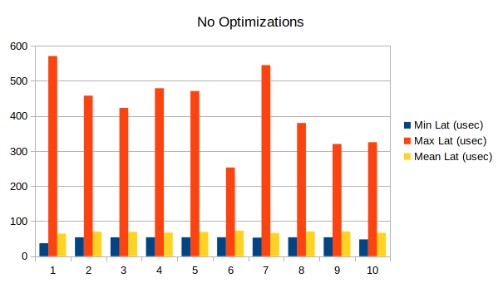
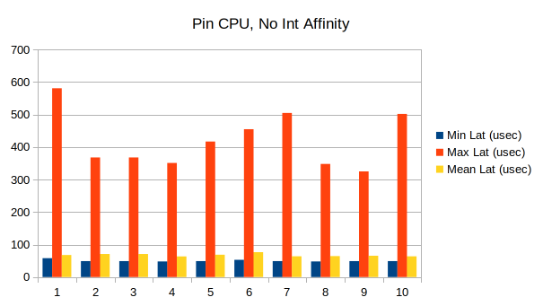
Benchmarks
Avg Min Lat: 51.6 usec
Avg Mean Lat: 68.7 usec
Avg Min Lat: 50.1 usec
Avg Mean Lat: 67.6 usec
NetDev 0x16, Lisbon, Portugal

Slide 8
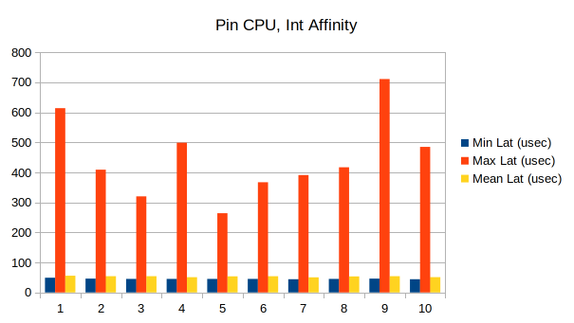
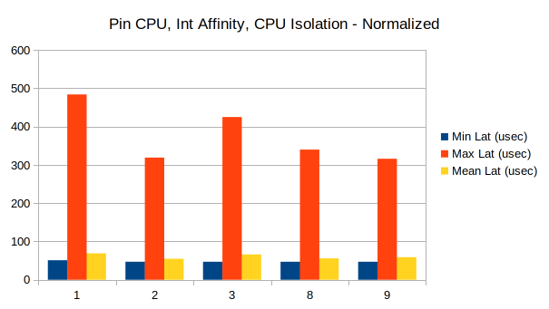
Benchmarks
Avg Min Lat: 45.4 usec
Avg Mean Lat: 53.1 usec
Uh-oh...
Avg Min Lat: 47.8 usec
Avg Mean Lat: 61.1 usec
NetDev 0x16, Lisbon, Portugal

Slide 9
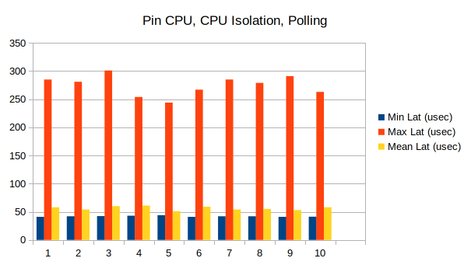
Benchmarks
Avg Min Lat: 41.9 usec
Avg Mean Lat: 56.3 usec
NetDev 0x16, Lisbon, Portugal

Slide 10
Benchmarks vs. HFT
Synthetic benchmarks don’t match real-world
HFT environment allows synthetic benchmark become reality
  CPU isolation
  CPU affinity (pin to specific cores)
  Polling (no interrupts)
  CPU power states disabled
  CPU mitigations disabled
NetDev 0x16, Lisbon, Portugal

Slide 11

AF_XDP to the rescue?
Throw eBPF at the problem!
NetDev 0x16, Lisbon, Portugal

Slide 12
AF_XDP to the rescue?
Kernel bypass without the bypass…
Hotpath passthru, control traffic to the kernel
Rx cannot be in NAPI / SOFTIRQ mode
  Must poll on Rx, ideally from userspace context
Tx still requires sendmsg() to initiate transmit
  System call context switches introduce jitter
NetDev 0x16, Lisbon, Portugal

Slide 13
CPU Isolation Challenges
isolcpus boot parameters work great…
...until they don’t
Sources of “random” IPI’s still exist
LPC 2022 CPU isolation MC
System-wide TLB shootdown patches in progress
NetDev 0x16, Lisbon, Portugal

Slide 14
HPC in HFT
Exchange interaction requires standard Ethernet at edge
HPC / Grid environments more purpose-built
RDMA a much more popular candidate for Grid networks
Quantitative research on massive datasets
  Massively-parallel CPU’s can’t wait on one another...
Predictable latency is still paramount!
NetDev 0x16, Lisbon, Portugal

Slide 15
io_uring for HPC?
io_uring showing great potential
  Originally meant to replace libaio
Recent advances showcasing how versatile it is:
  https://kernel-recipes.org/en/2022/whats-new-with-io_uring/, Jens Axboe
  https://lpc.events/event/16/contributions/1213/, Josh Triplett
Submitting data to hardware-mapped rings to io_uring structs
NetDev 0x16, Lisbon, Portugal

Slide 16
RoCE for HPC?
RDMA is still king in HPC networks
Infiniband is niche
  Expensive
  Management / administration skillsets differ from Ethernet
RoCE or iWARP have own challenges
  Converged networks still have jitter
  Often needs other tech like DCB
NetDev 0x16, Lisbon, Portugal

Slide 17
Homa for HPC?
New RPC-based approach similar to RDMA Verbs
Having both kernel and userspace support interesting
Could allow standardization of network switch hardware
Could make application development easier
NetDev 0x16, Lisbon, Portugal

Slide 18
Are there others?
Possible RDMA replacements for HFT?
Must eliminate jitter
Must be lowest-latency possible
Predictable latency!!
NetDev 0x16, Lisbon, Portugal

Slide 19
Recap
HFT has two distinct problem spaces:
  Exchange / trading environments
  HPC environments
Predictable latency is paramount
  Trading strategies assume comm latency to be predictable
  Kernel CPU isolation still needs work
RDMA may be challenged by emerging technologies
  AF_XDP
  io_uring showing great promise
  Homa and other emerging protocols attacking latency
NetDev 0x16, Lisbon, Portugal

Slide 20

Questions?
NetDev 0x16, Lisbon, Portugal

